Slide 1
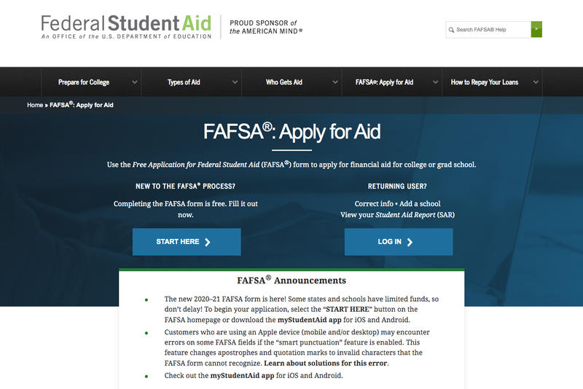
www.FAFSA.gov

Slide 2
Objectives
What is Financial Aid?
How do I receive Financial Aid?

Slide 3
Now let’s get started
“Run”

Slide 4
What do you want to be when you grow up?

Slide 5
Oh you were too “busy” to fill out your FAFSA?
Must’ve been doing something very important.

Slide 6
Excuses we’ve heard
My Parents Make Too Much Money, So I Won't Qualify for Financial Aid
My Parents Are Undocumented, So I Can't Apply for Federal Student Aid The FAFSA does not ask parents about their citizenship status. Undocumented students cannot receive federal financial aid, but the citizenship of parents has no bearing on aid eligibility.
By Providing Their Information, My Parents Become Responsible for Paying for College
If My Financial Situation Changes, There's Nothing I Can Do About It
Determinations of Financial Aid Are Final

Slide 7
What is Financial Aid?
“The fast break”
Aid that comes from the federal government that helps parents and students pay for college
Grants
Work Study
Loans
Scholarships

Slide 8
GRANTS
Money you receive that you do not have to pay back
Based on your family’s ability to pay the cost of your education

Slide 9
Subsidized Loans
The federal government pays the interest while you are in school.
Unsubsidized Loans
The interest will accrue while you are in school.
PLUS
Parent Loans for Undergraduate Students.
Private Loans
The interest also accrues while you are in school.
Except PLUS; All loan repayments start 6 months after you graduate, cease to enroll, or cease to enroll at least half time.

Slide 10
WORK STUDY
Provides part-time employment while you are enrolled in school
Available to full-time or part-time students
Most times you create your own schedule

Slide 11
SCHOLARSHIPS
Money you receive that you do not have to pay back
Maybe based on your major, grades, and other criteria

Slide 12
Are you an Independent or a Dependent student?
Can you answer “yes” to any of the following questions?

Slide 13
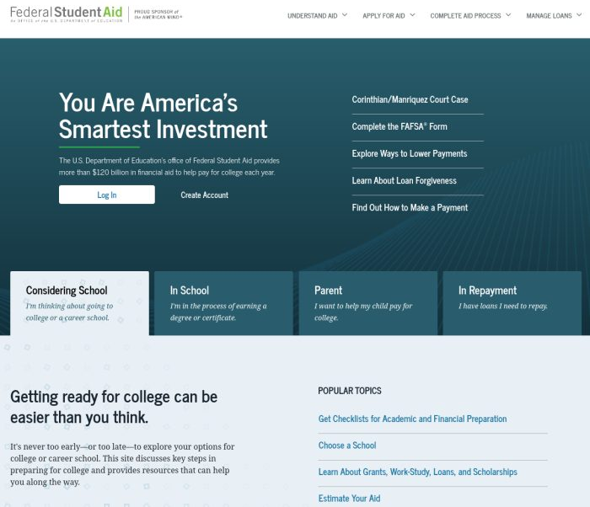
Create an ID
www.studentaid.gov
Select Create account & Get Started
Password can not be any portion of your (name, social, birth)
Write it down or take a picture
Use your personal Email Address not your school or Parents
Take a picture of your challenge questions
You will receive a verification code on your cell and email
*** One parent has to create and ID as well***

Slide 14
Why do we need parents’ tax information?
Under Federal law to the extent your family is able, they are primarily responsible for paying for college expenses for dependent students.
There are special circumstances
Student loans have nothing to do with the parent unless it’s a PLUS loan.

Slide 15
Which Parent to use on FAFSA
Unmarried with boyfriend/Girlfriend: Parent only
Remarried: Parent and Step parents information
Court Ordered Custody: Use the custodial parents information
Emancipated Minor: Use your information only (you will have to provide roof of your emancipation
Homeless: Use your information only (you will have to provide proof of homelessness
Notarized letter of custody: You will use your biological parent unless the college makes provision for you

Slide 16
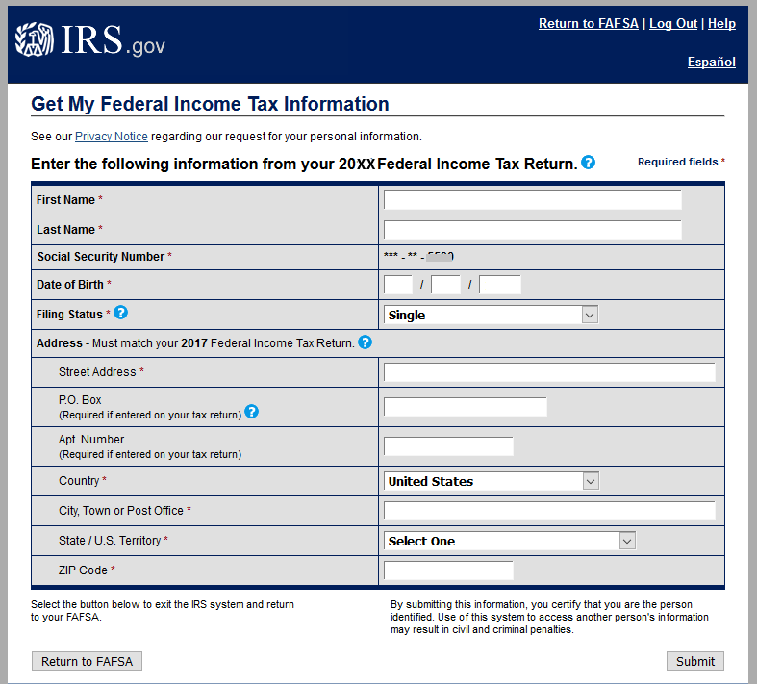
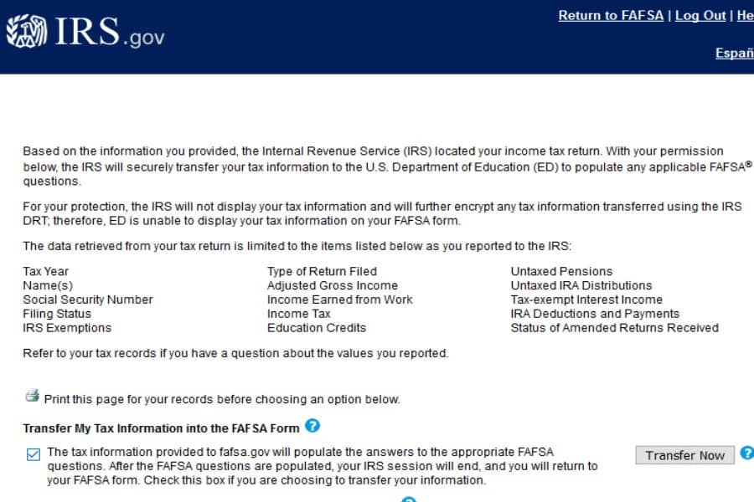
Up load taxes from the IRS on FAFSA

Slide 17
Don’t sleep on Small Colleges
TRUE SCENARIO’s
Student A: Student B: Student C:
Pell: 3100 Pell: 1500 Pell: 3100
FSAG: 1200 Bright future:950 -1500.00
____________ scholarship:500 __________
4300.00 _________________ 1600.00
-1500.00(class) 2950 -500
_____________ -1500 ___________
2800.00 ________________ 1100.00 refund
-500 (books) 1450.00
____________ -500
2300.00 (refund) _________________
950 (refund)

Slide 18
Need to Know
FAFSA starts Oct 1st every year
Everyone should complete a FAFSA
Make sure you complete the 21-22 for Fall semester of college
If you do not add the school the college will not get your information
It’s first come; First served (remember it started in October
You’re not alone
Get help for Free

