Slide 1
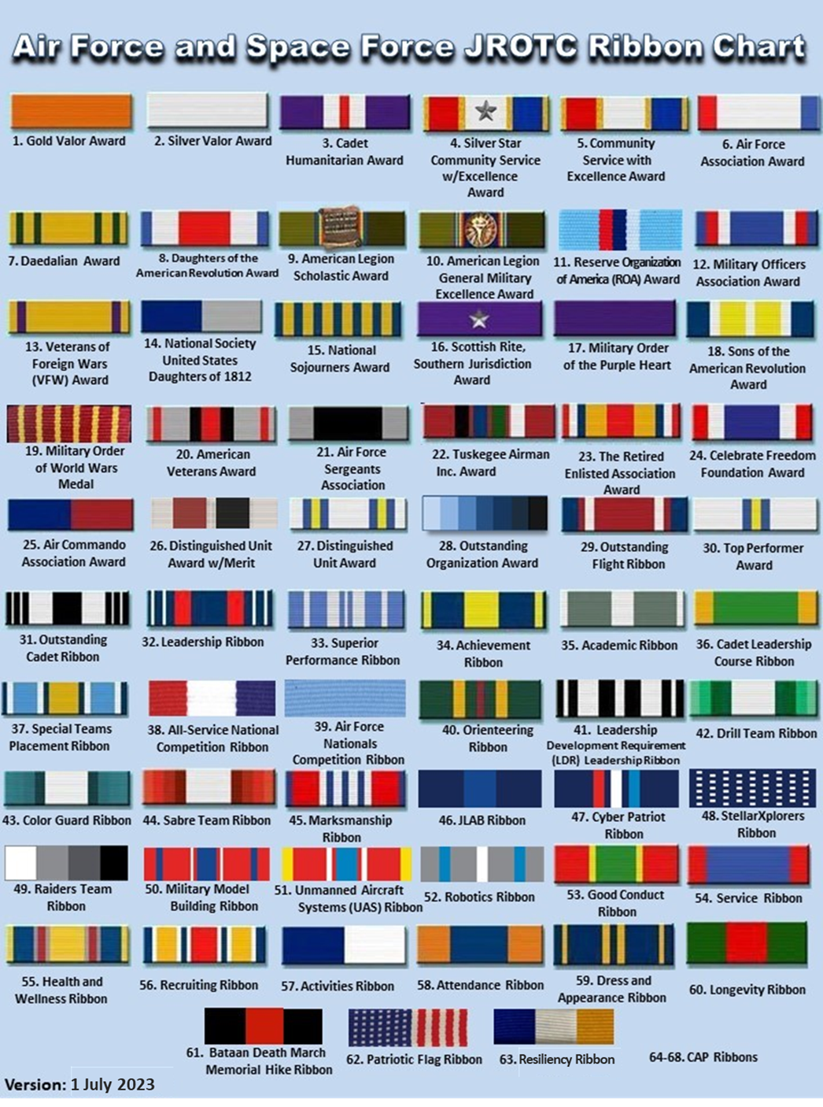
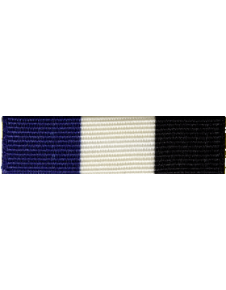

46. USAA Education Foundation JLAB Ribbon
1 Sep 2023

