Slide 1
Hamilton County High School
Junior Parent Night

Slide 2
HCHS Student Services
Guidance Counselor - HS
Mrs. Elizabeth Mitchell
elizabeth.mitchell@hamiltonfl.com
792-8113
Guidance Counselor - MS
Mr. Scott Connelly
scott.connelly@hamiltonfl.com
792-8118
Data Clerk
Mrs. Ragan Carnley
ragan.carnley@hamiltonfl.com
792-8117

Slide 3
HCHS Student Services
CTE Coordinator
Mr. Clayton Tomlinson
clayton.tomlinson@hamiltonfl.com
792-8105
Teacher Support Colleague
Mr. Louis Daniels
louis.daniels@hamiltonfl.com
792-8171
Testing Coordinator
Mrs. Phyllis Harris
phyllis.harris@hamiltonfl.com
792-8116

Slide 4
HCHS Student Services
Social Emotional Learning/Health
Ms. Tiffany Criswell
tiffany.criswell@hamiltonfl.com
792-8128
Social Worker
Mrs. Maria Marrero
maria.marrero@hamiltonfl.com
792-8120

Slide 5
HCHS Guidance Website
http://hch.hamiltonfl.com/guidance

Slide 6
Graduation Requirements
24 Credits
2.0 grade-point average (GPA)
Testing Requirements
Grade 10 English Language Arts (ELA) or a concordant score
Algebra 1 end of course (EOC) or a comparative score

Slide 7
Honors/Rank in class

Slide 8
College board opportunity scholarship

Slide 9
www.nfc.edu

Slide 11
Associate in Arts Degree The A.A. degree is the basic university transfer degree and the equivalent of the first two years of a bachelor's degree. Florida's "2+2" articulation agreement guarantees NFC's A.A. graduates admission to one of the 12 state universities. (see an advisor for specific details and degree transfer credits; admission not guaranteed to limited access programs)
NFC is a great place to start your college journey.
Dual Enrollment Options | University Transfer | Smaller Classes - Quality Instruction
Save money on tuition at NFC + Earn a quality education

Slide 13
Career and Workforce Education From quick industry certifications to bachelor's degree, North Florida College's Career and Workforce Education programs can help provide training to boost your career. Explore NFC training for workforce-recognized credentials, nationally accredited programs and degrees.
NFC offers building blocks to careers and degrees.
Quick Workforce Certifications | Online Programs | Certificates and Degrees

Slide 15
NFC IS HERE TO HELP!
Getting Started at NFC
Student Resources at NFC
Online Admission Application Enrollment Checklist www.nfc.edu/getting-started/admissions
NFC Recruiter
NFC Advisors
Financial Aid Options www.nfc.edu/getting-started/financial-aid
Complete the FAFSA early
NFC Scholarships www.nfc.edu/foundation-giving/scholarships
NFC Foundation Office
Complete the FAFSA
Apply by deadline
Learning Resources and Academic Success Center www.nfc.edu/learning-resources
Free Tutoring
Academic Coaching
Test Review Workshops
Study Skills and More
Academic Advising
Academic Review and Career Guidance
Disability Resource Center
Student Counseling
Student Activities www.nfc.edu/current-students/campus-life

Slide 16
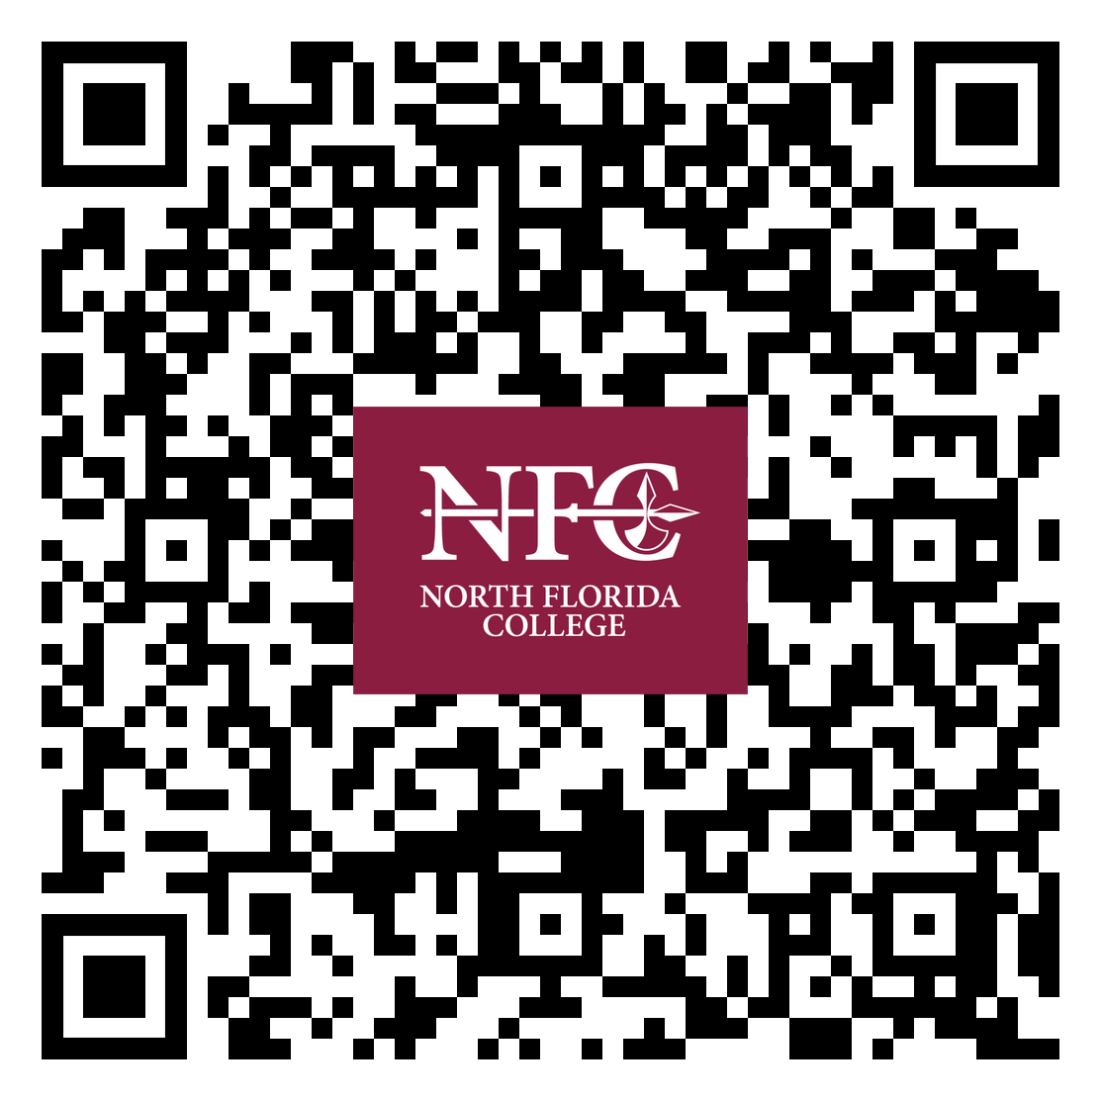
WWW.NFC.EDU
Request more information about NFC online.
Scan QR code with phone camera or QR code scanner.
CONTACT: Allison Finley
NFC Recruitment Coordinator | 850-973-9407 | Recruiting@nfc.edu or FinleyA@nfc.edu

Slide 17
Seth Wilkins
Blue and Gold Officer
386-364-3699
seth.wilkins@edwardjones.com
www.usna.edu

Slide 18
Hamilton County High School
Just Can’t Hide That Trojan Pride

