Slide 1
Hamilton County High School
Senior Orientation
Parent Night

Slide 2
HCHS Administration
Principal
Mr. Ryan Mitchell
ryan.mitchell@hamiltonfl.com
Assistant Principal
Ms. MJ Kinard
mary.kinard@hamiltonfl.com
Dean - HS
Mr. Rodrick Randolph
rodrick.randolph@hamiltonfl.com
Dean - MS
Mr. Scott Connelly
scott.connelly@hamiltonfl.com

Slide 3
HCHS Student Services
Guidance Counselor - HS
Mrs. Elizabeth Mitchell
elizabeth.mitchell@hamiltonfl.com
792-8113
Guidance Counselor - MS
Ms. Amy Yarick
amy.yarick@hamiltonfl.com
792-8118
Data Clerk
Mrs. Niki Martin
wendy.martin@hamiltonfl.com
792-8117

Slide 4
HCHS Student Services
CTE Coordinator
Mr. Clayton Tomlinson
clayton.tomlinson@hamiltonfl.com
792-8105
Teacher Support Colleague
Mr. Louis Daniels
louis.daniels@hamiltonfl.com
792-8171
Testing Coordinator
Mrs. Phyllis Harris
phyllis.harris@hamiltonfl.com
792-8116

Slide 5
HCHS Student Services
Social Worker
Mrs. Maria Marrero
maria.marrero@hamiltonfl.com
792-8120

Slide 6
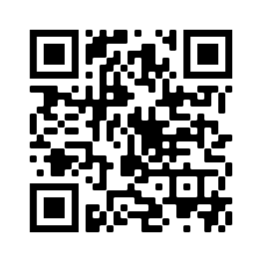
HCHS Guidance Website
http://hch.hamiltonfl.com/guidance

Slide 7
Graduation Requirements
24 Credits
2.0 grade-point average (GPA)
Testing Requirements
Pass Grade 10 English Language Arts (ELA) or a concordant score
Pass Algebra 1 end of course (EOC) or a concordant score
Participate:
Geometry EOC,
Biology EOC,
US History EOC,
US Government (Florida Civics Literacy Exam)

Slide 8
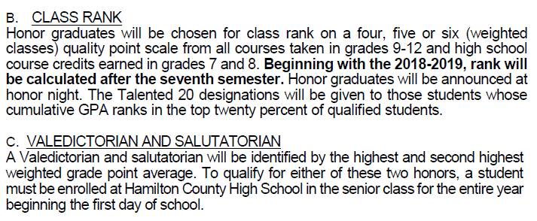
Honors/Rank in class

Slide 9
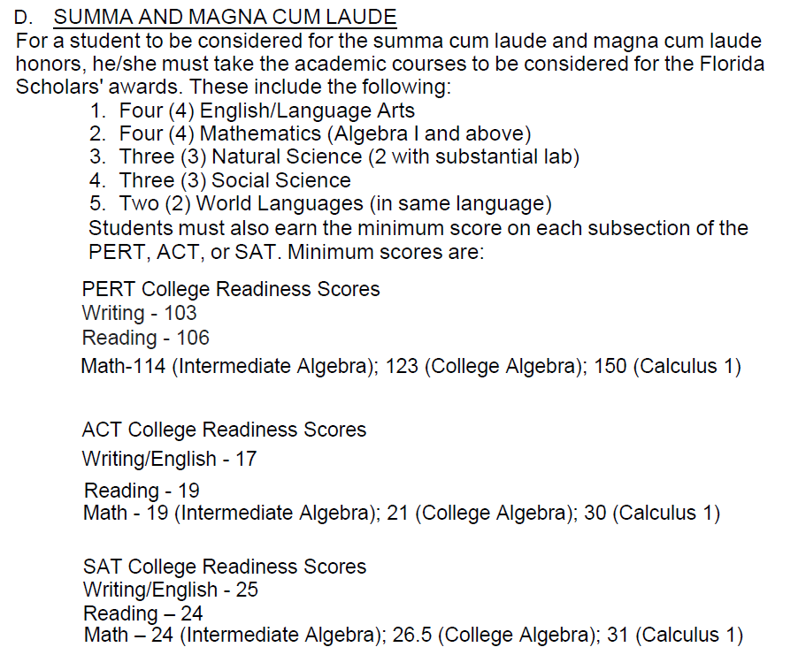
Honors/Rank in class

Slide 10
Honors/Rank in class

Slide 11
Local HCHS Scholarships
Scholarship Meeting:
Thursday, February 2nd 9:05am (2nd Period)
Hard Copies will be available in Guidance
Electronic copies will be provided via the Guidance website
Resume
Letters of Recommendation
Community Service Hours
Deadlines

Slide 12
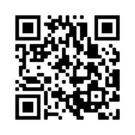
Scholarship Website
http://hch.hamiltonfl.com/scholarships

Slide 13
FAFSA
Free Application for Federal Student Aid
FAFSA Night
Tuesday, October 11th at 6pm
https://studentaid.gov/h/apply-for-aid/fafsa

Slide 14
Florida Scholarships
Office of Student Financial Assistance
https://www.floridastudentfinancialaidsg.org/SAPHome/SAPHome?url=home

Slide 15
Bright Futures
https://www.floridastudentfinancialaidsg.org/SAPBFMAIN/SAPBFMAIN

Slide 16
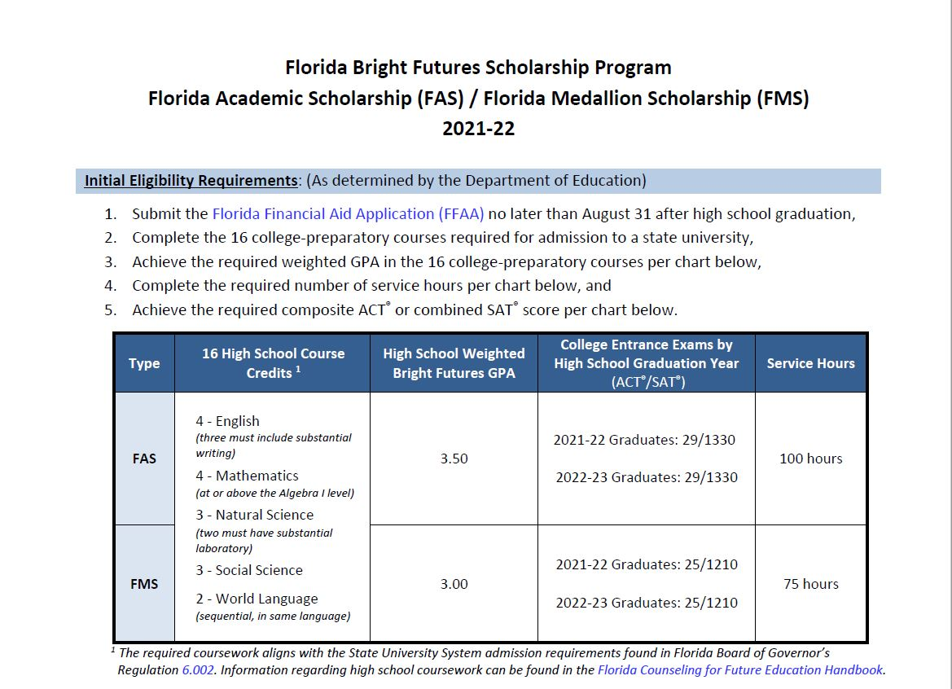
Bright Futures

Slide 17
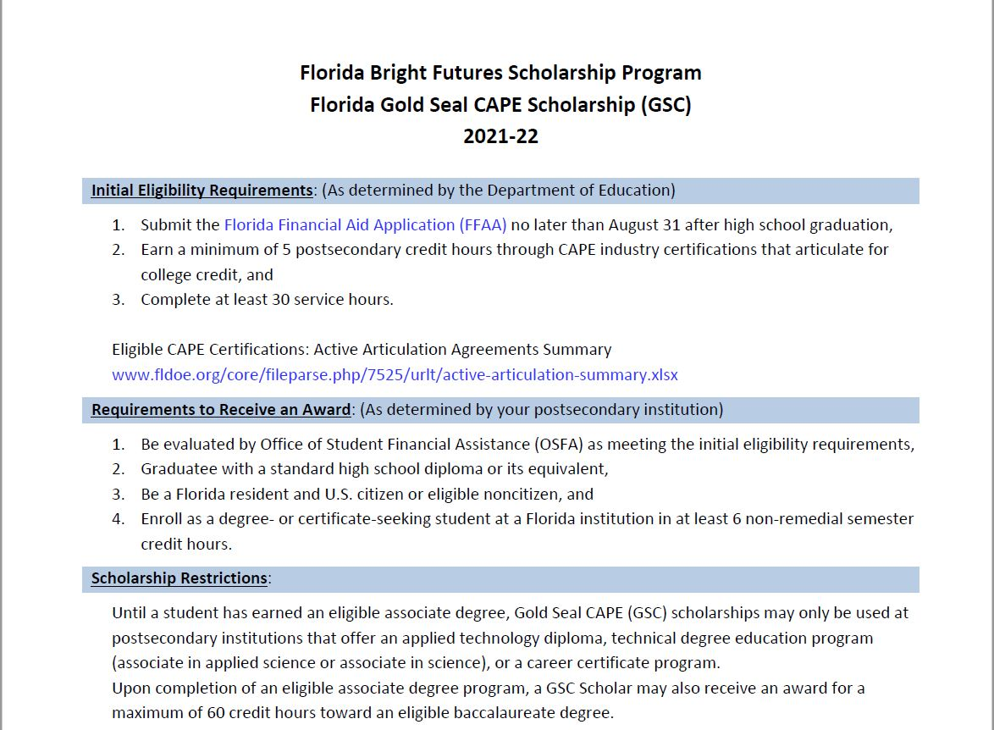
Bright Futures

Slide 18
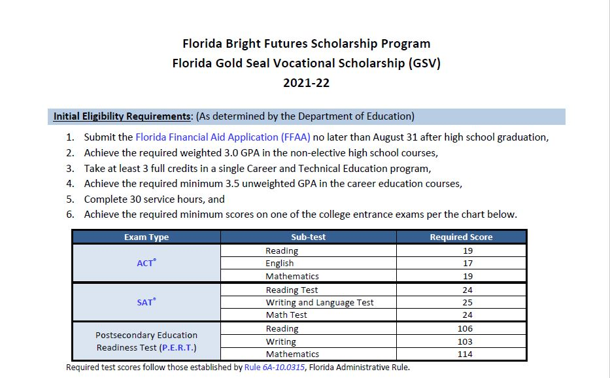
Bright Futures

Slide 19
BigFuture Scholarships

Slide 20
Grad Bash

Slide 21
Grad Bash
Friday, April 28th
Cost = $180
3 payments of $60
Sponsor: Mrs. Deas

Slide 22
Hamilton County High School
Just Can’t Hide That Trojan Pride

